Slide 1
Mediator
Group 8:
1551018 – Huỳnh Vĩnh Lộc
1551039 – Trần Thoại Thông
1551044 – Trần Văn Duy Tuệ
1551048 – Trần Lê Vũ

Slide 2
Creational Pattern
Design Pattern
Software Design
Pattern
Behavioral Pattern
Identify
Communication Patterns
Structural Pattern
Realize these patterns

Slide 3
Behavioral
Pattern
Mediator Pattern
Observer Pattern

Slide 4
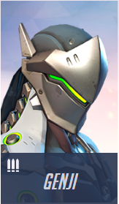

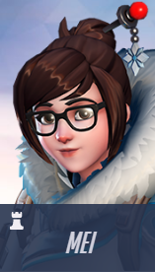
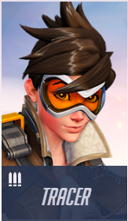
COMMUNICATION

Slide 5

HELP ME!
Type | Name
Vector<user*> | Contact
void | SendMessage(User, Msg)

Slide 6
Coupling
Object

Slide 7
Coupling
HIGH COUPLING

Slide 8
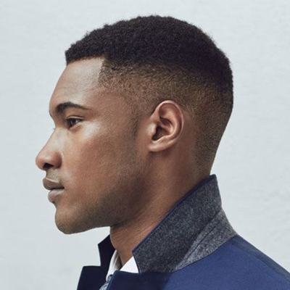
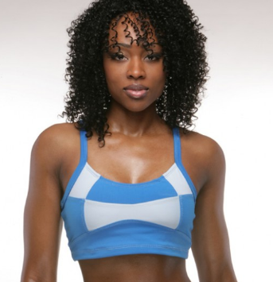
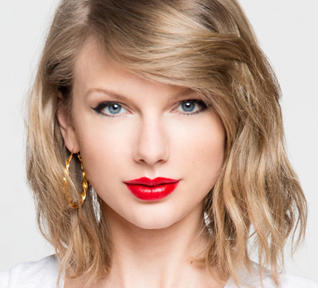
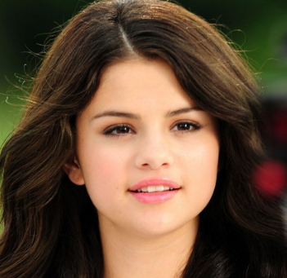
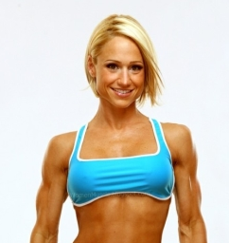
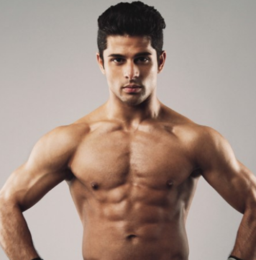
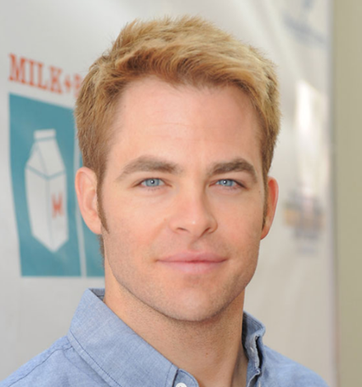
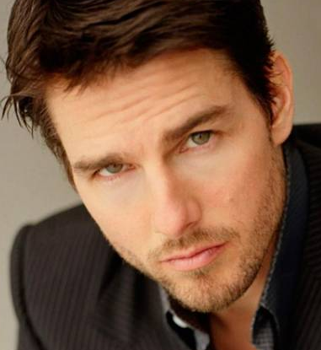
Black
Singer
Gym
Blonde
Actors
Notes:
^

Slide 9
Singer
Blonde
Actors

Slide 10
Mediator
Define how a group of objects interact
Keeping objects from referring each other explicitly
Vary their interaction independently
Separate objects from keeping unnecessary relations

Slide 11

Structure
Colleagues (ex: students, teachers) does not required to “know” each other
Each talks to the mediator, which than transferred to corresponding colleagues.
Otherwise, “many to many” mapping exist.
Mediator (ex: class monitor) has two-way links to all of its colleagues.
Monitor
Who is the TAs of CS202?
I need to know all of the students and teachers

Slide 12
User
-Vector<User>: Users
+sendMess ( , Message)
+receiveMess ( , Message)
User
Normal
Solution
User
Message
+content: String
+User*: Sender

Slide 13

User
-Vector<User>: Users
+sendMess ( , Message)
+receiveMess ( , Message)
Group Chat
-Vector<User>: Members
+sendMess (User, Message)
+receiveMess (User, Message)
GroupChat
User
GroupChat
User
Message
+content: String
+User*: Sender

Slide 14
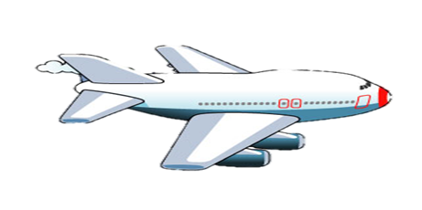
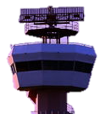

Slide 15

Method: Give Assignments
Monitor
Teacher

Slide 16
Method: Submit Assignments
Monitor
Teacher

Slide 17
Teacher
-Monitor*: monitor
+sendMessage (User, Message)
+receiveMess (User, Message)
Monitor : Student
-Vector<Student>: ClassMate
-Vector<Teacher>: Teachers
+sendMessage(User, Message)
+receiveMess(User, Message)
Student
-Monitor*: monitor
+sendMessage (User, Message)
+receiveMess (User, Message)
Lương
Algebra Teacher
Sammy
Dean
Physics Teacher
Thomas
Evelynn
Communication Teacher
Usher
Norman
Timothy
Science Teacher

